Slide 2
Java 4 WEB
Lesson 4 – Home tasks overview

Slide 3
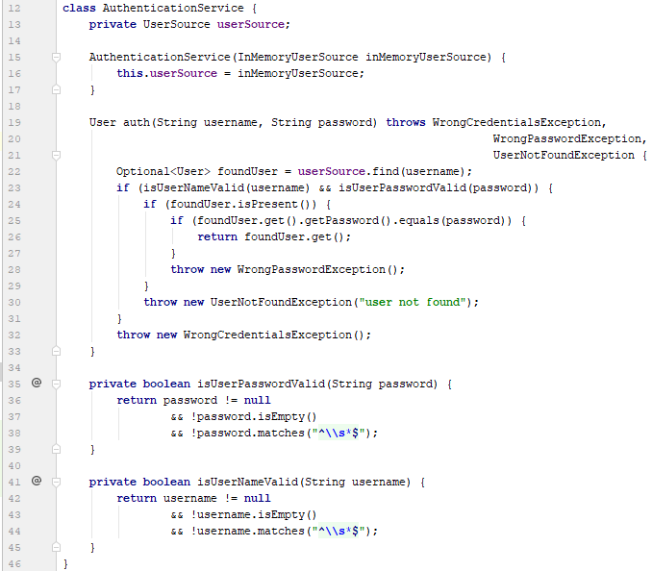
1. Do not declare unchecked exceptions

Slide 4
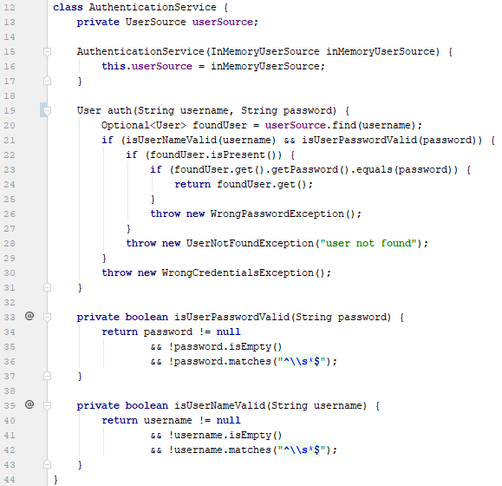
1. Do not declare unchecked exceptions

Slide 5
2. Prefer abstractions

Slide 6
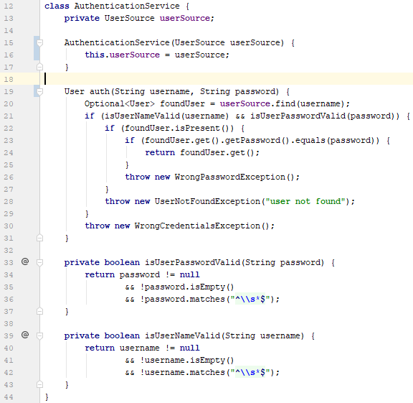
2. Prefer abstractions

Slide 7
3. Method name should describe purpose

Slide 8
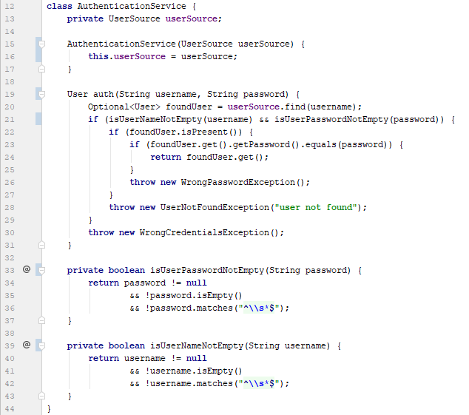
3. Method name should describe purpose

Slide 9
4. Do not repeat your self

Slide 10
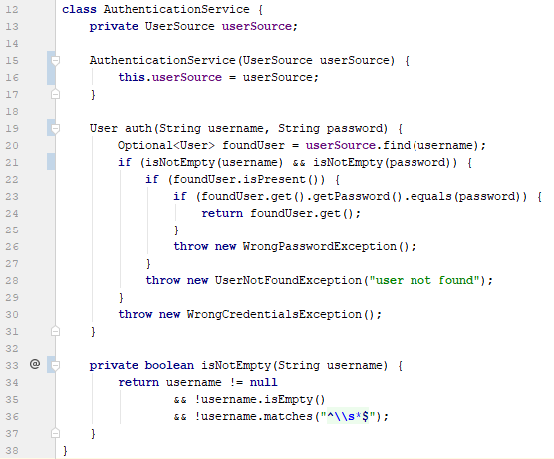
4. Do not repeat yourself

Slide 11
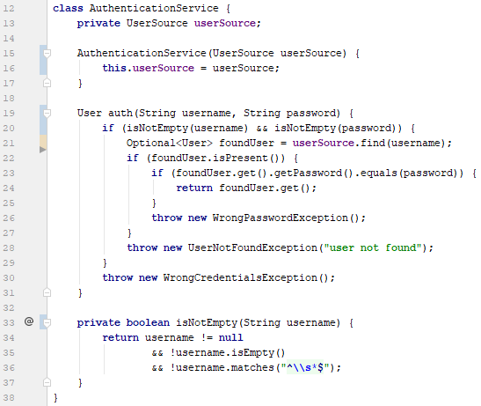
5. Do not make extra operations
Notes:
Invoke db only after validation

Slide 12
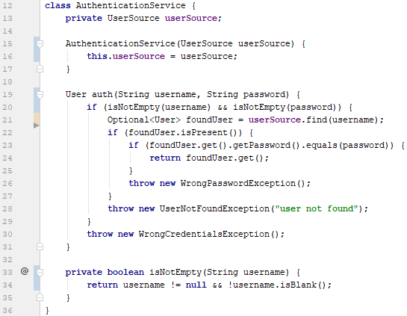
5. Do not make extra operations

Slide 13
6. Do not make >2 inner blocks

Slide 14
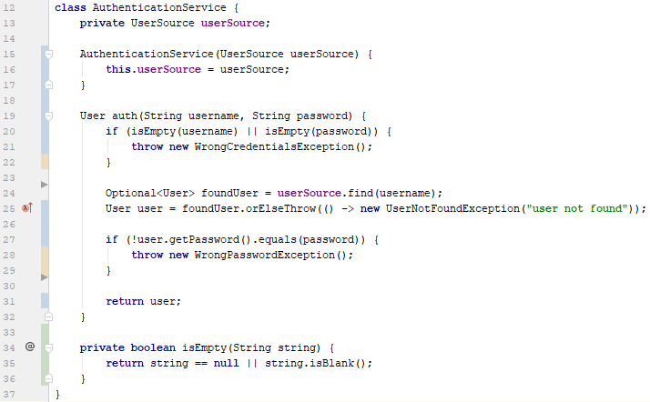
6. Do not make >2 inner blocks

Slide 15
7. Do not duplicate error info

Slide 16
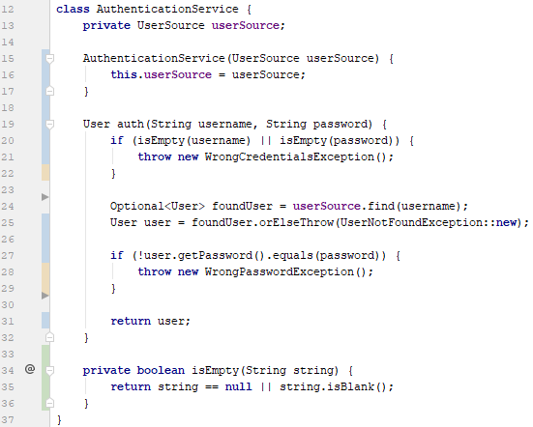
7. Do not duplicate error info

Slide 17
8. Reuse code

Slide 18
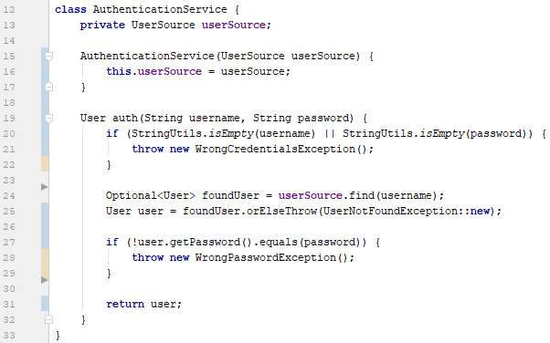
8. Reuse code

Slide 19
8 Before and After

Slide 20
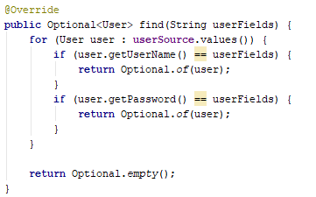
9. Wrong user lookup
Notes:
Why user is retrieved by password?

Slide 21
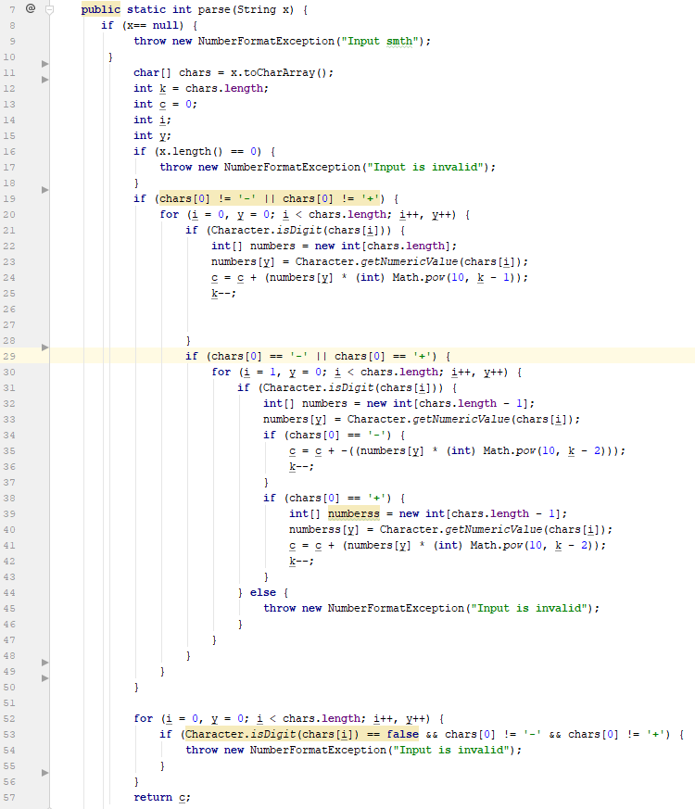
10. Bad big code
Notes:
Who can guess where is the sign check?

Slide 22

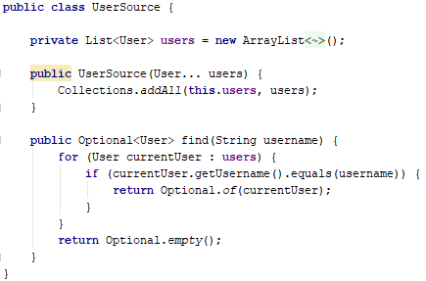
11. Do not inherit user source
Notes:
Avoid inheritance
Prefer composition

Slide 23
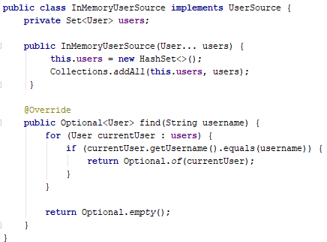

11. Do not inherit user source

Slide 24
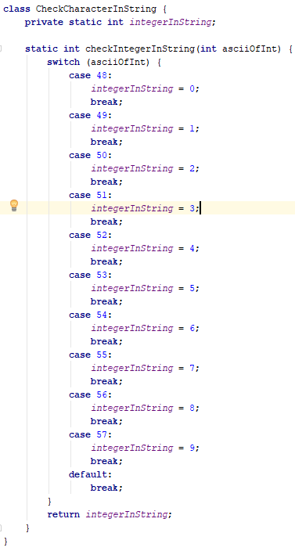
12. Use built-in code

Slide 25
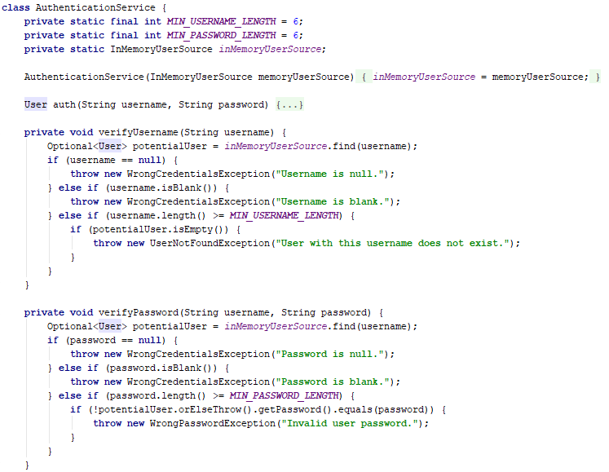
13. Do not implement extra code

Slide 26
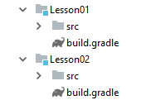
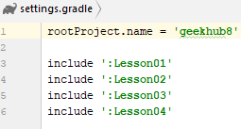
14. Add Gradle support in lesson 01/02

Slide 27
15. Better commit messages
L04-T1 Implement InMemoryUserSourceTest
L04-T1 Implemented Number parser test
L04-T1 Changed logic of method
L04-T2 "working task"

